Slide 1
Project Presentation Team 10

Slide 2
How We Chose the Data – Train Ticket and Distance Information
Initially we had ideas about Forestry (Public Opinions) but then decided against it after the data we gathered was either too complex or too much to represent in its entirety. We then moved away from the idea completely and focused more upon data surrounding train information as this was much simpler and easier to represent. Eventually we decided on passenger kilometre and train ticket data because:
• Short and Simplistic
• Easy to display
• Compatible
• Data could be shown over a large time scale (1940s – Current Day)

Slide 3
Potential Insights That We Considered
Mean Kilometres Travelled Per Year
Years with the Most/Least Kilometres Travelled
Differences between the Earliest and Latest Records
Display Certain Ticket Data Based on User Input (A specific year)
How Ticket Prices Have Changed from the Start and End of the Data
Possible Impact/s of Covid-19 on Certain Ticket Sales or Kilometres Travelled by Train

Slide 4
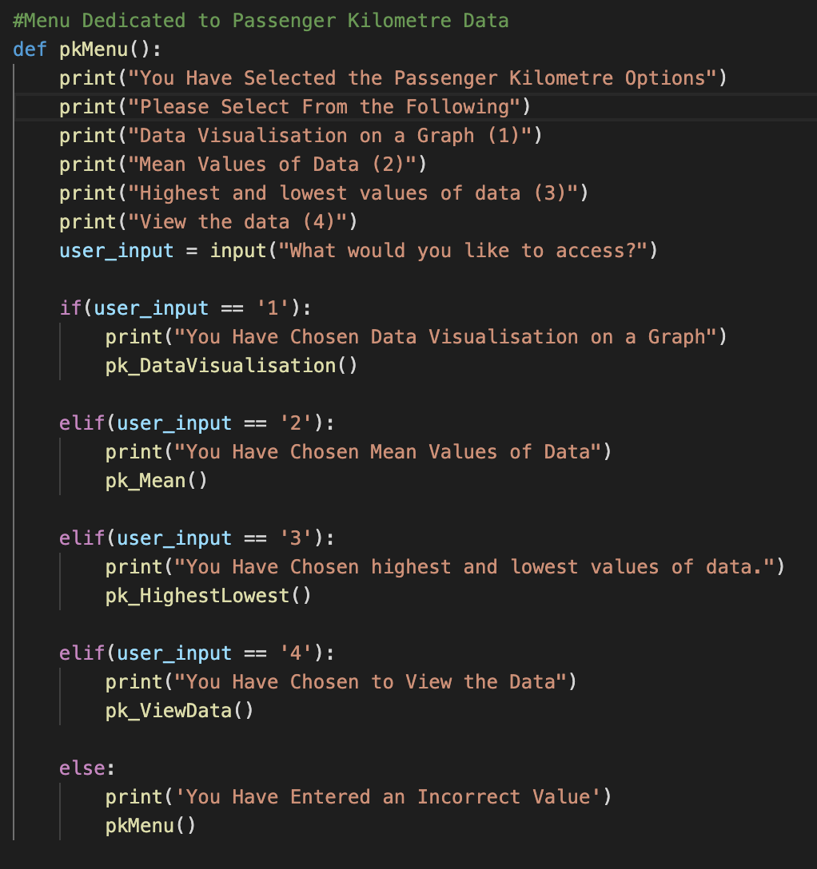
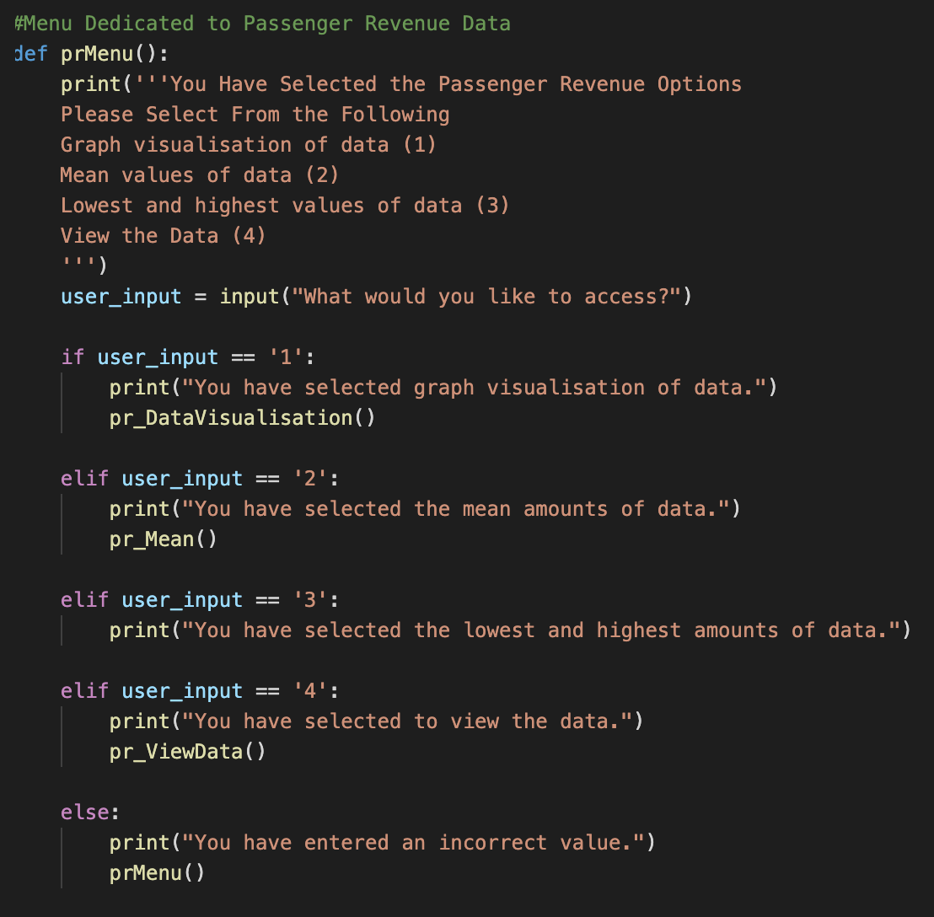
Algorithm Exploration
When implementing these insights into our program we determined the best way to do so would be to use a function for each insight in order to keep our code separate and easy to manage. Furthermore we also chose to use 2 menus to separate which data the functions belong to.

Slide 5
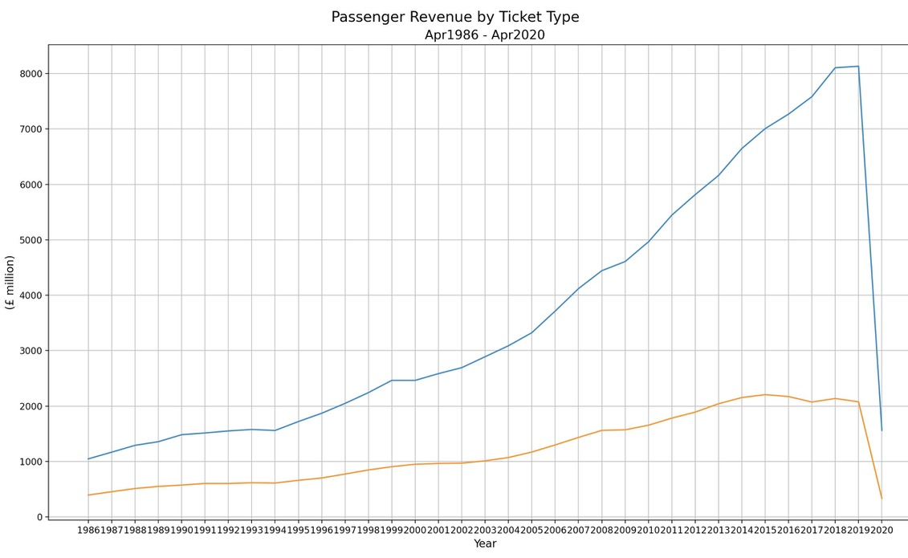
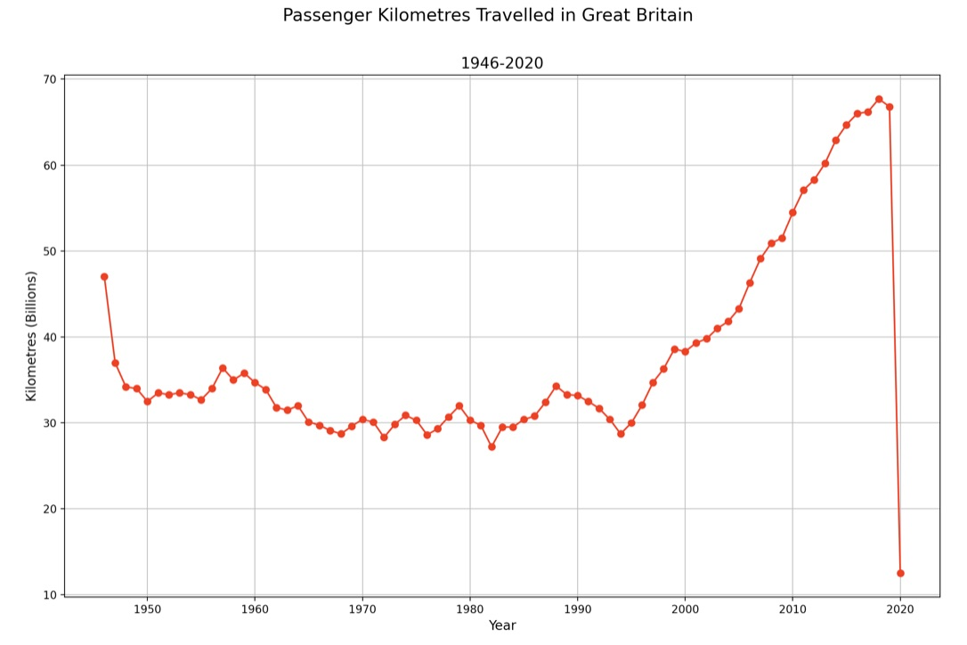
Visualisations
Regular Ticket
Season Ticket
Kilometers Travelled for a Specific Year

